Slide 1
Intro to ITWS - Term Project
Mental Health for Students
By: Jasmine Filawo, Bhavesh Bajaj, James Liu

Slide 2
Our Site
Our site is designed to help college students with their mental health
User interface is simplistic; pages can easily be accessed with links
Overall look of site is simplistic
We have many pages that describe various ways to alleviate stress (relaxation products, motivational quotes, schedule planning, etc.)
We have a mental health form/survey that asks users how they are doing and any products they like
There is also a page containing links to other resources that can help with stress

Slide 3
Mock-Up Plan
User interface was designed
Contained most of main content on site
Homepage design stayed consistent between plan and implementation
Designs of other pages were changed to match the overall design of the site
Overall, our project delivers on everything that the mock-up plan details

Slide 4
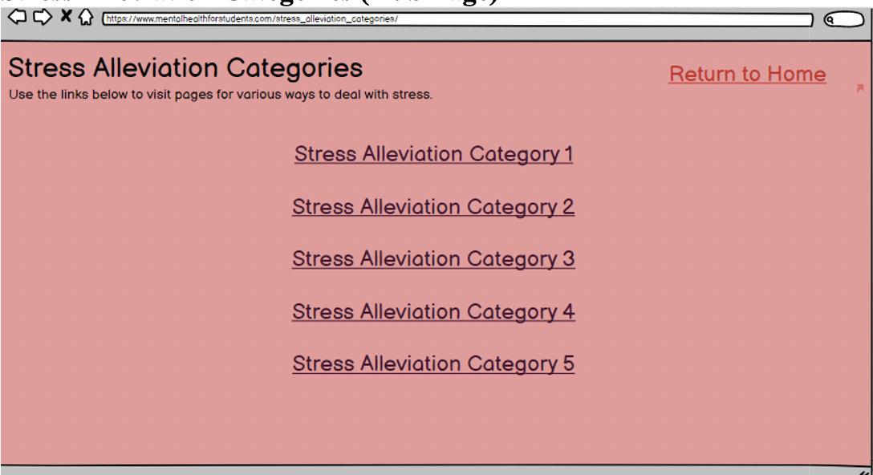
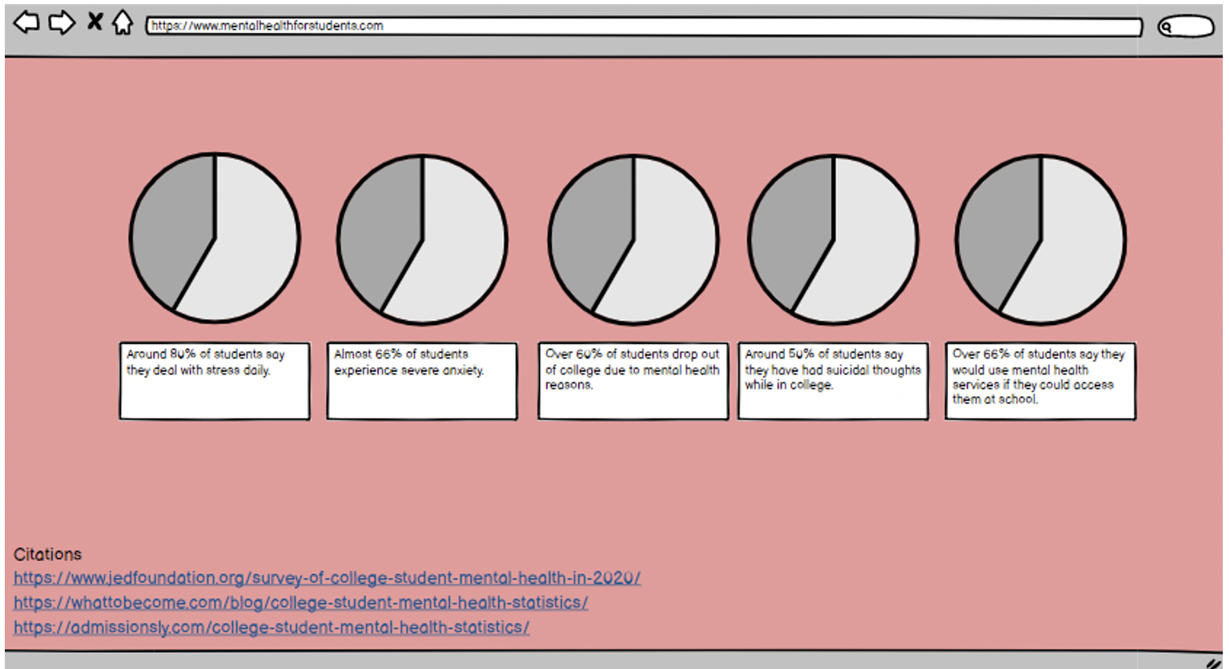
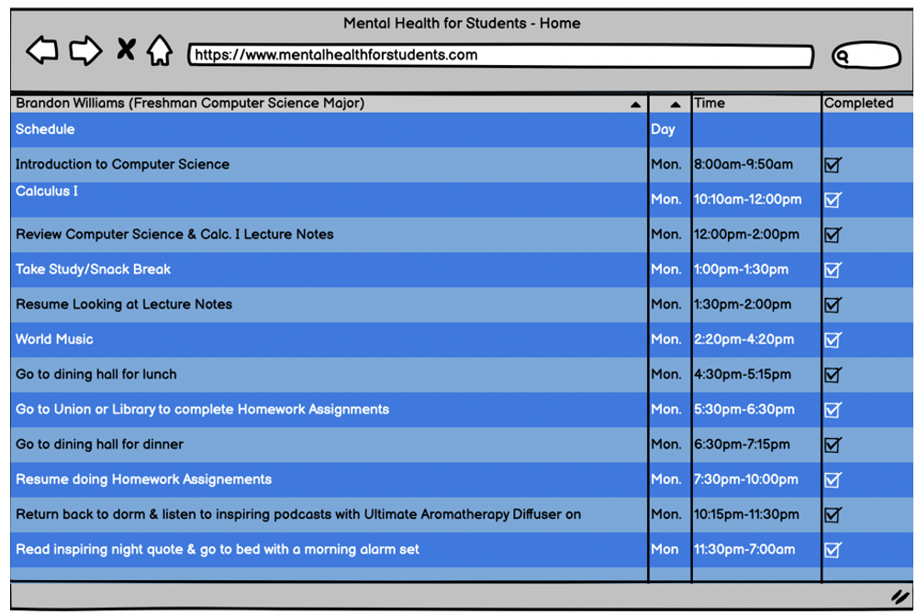
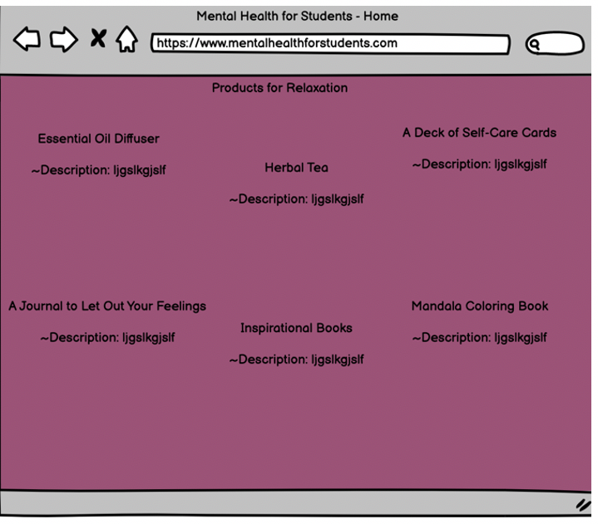
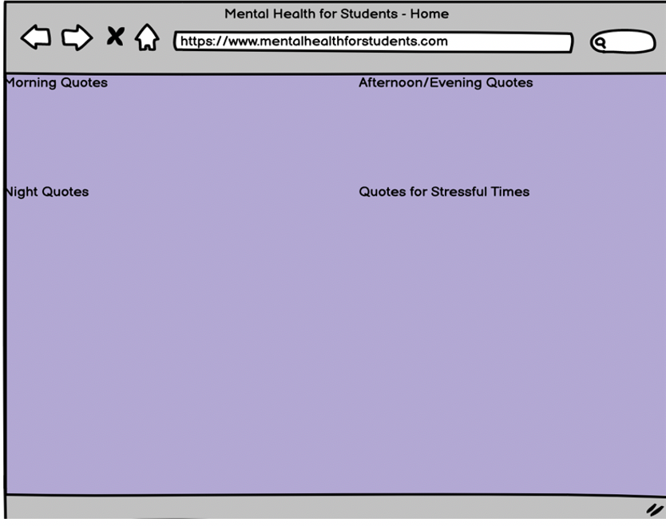
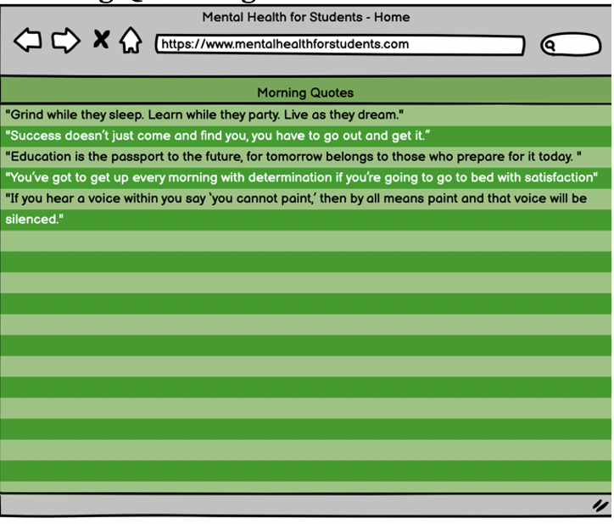

Slide 5
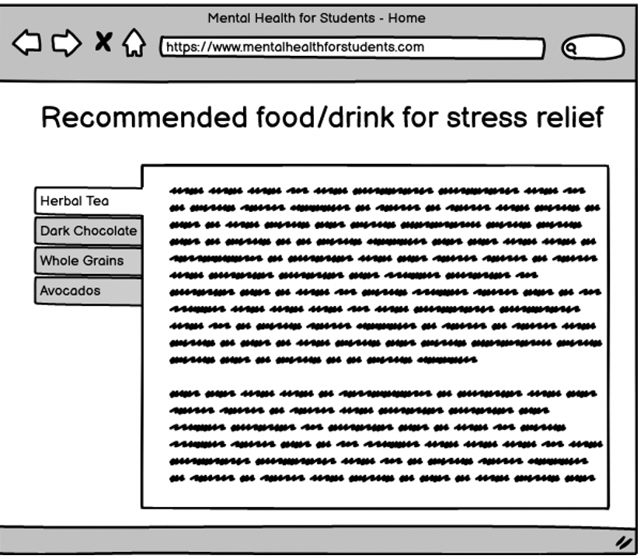
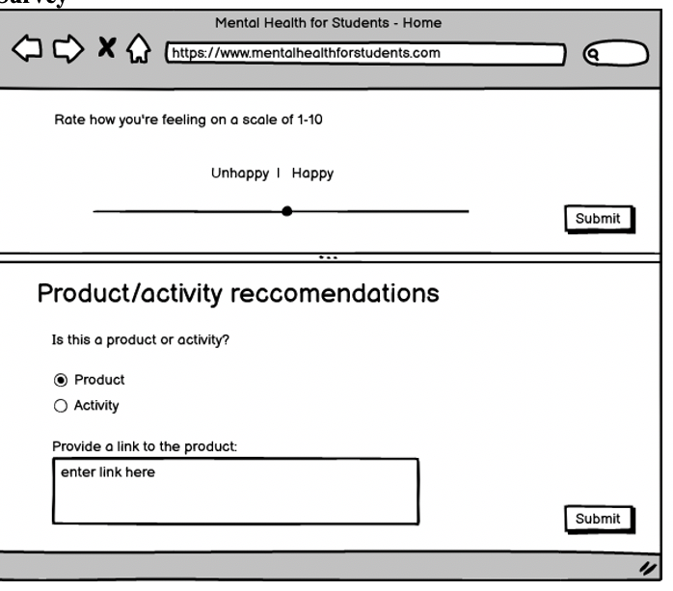

Slide 6
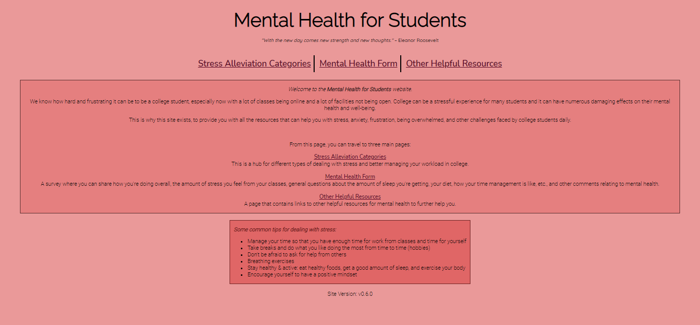
Navigation
Homepage:
Random motivational quote
Link bar
Site Description
Common Tips

Slide 7
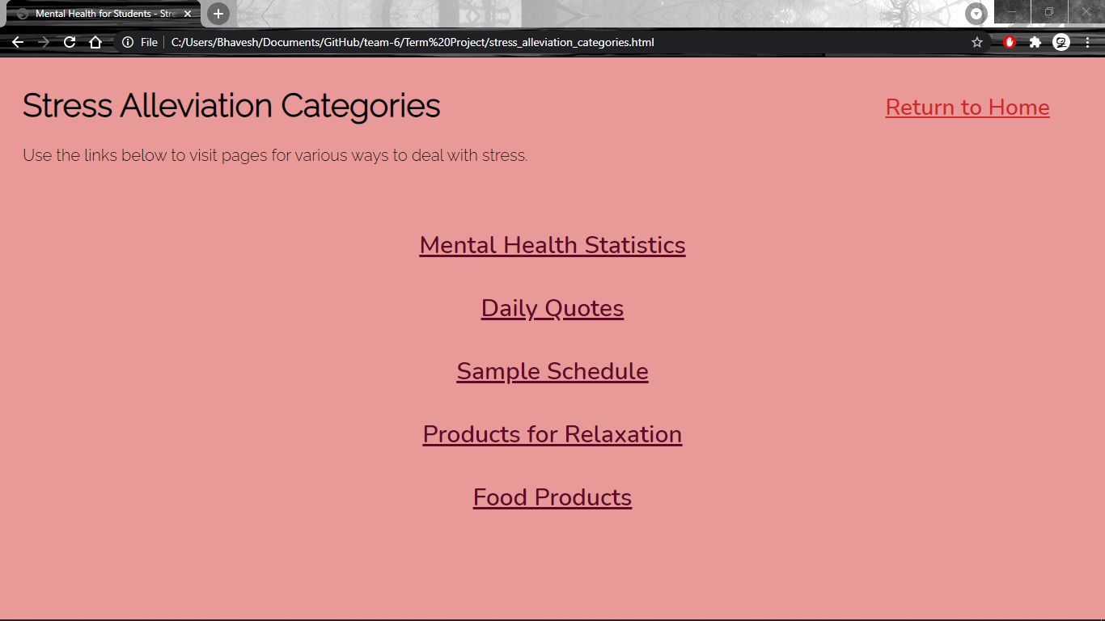
Navigation (continued)
Stress Alleviation Categories:
Links to various pages
Return link to homepage

Slide 8
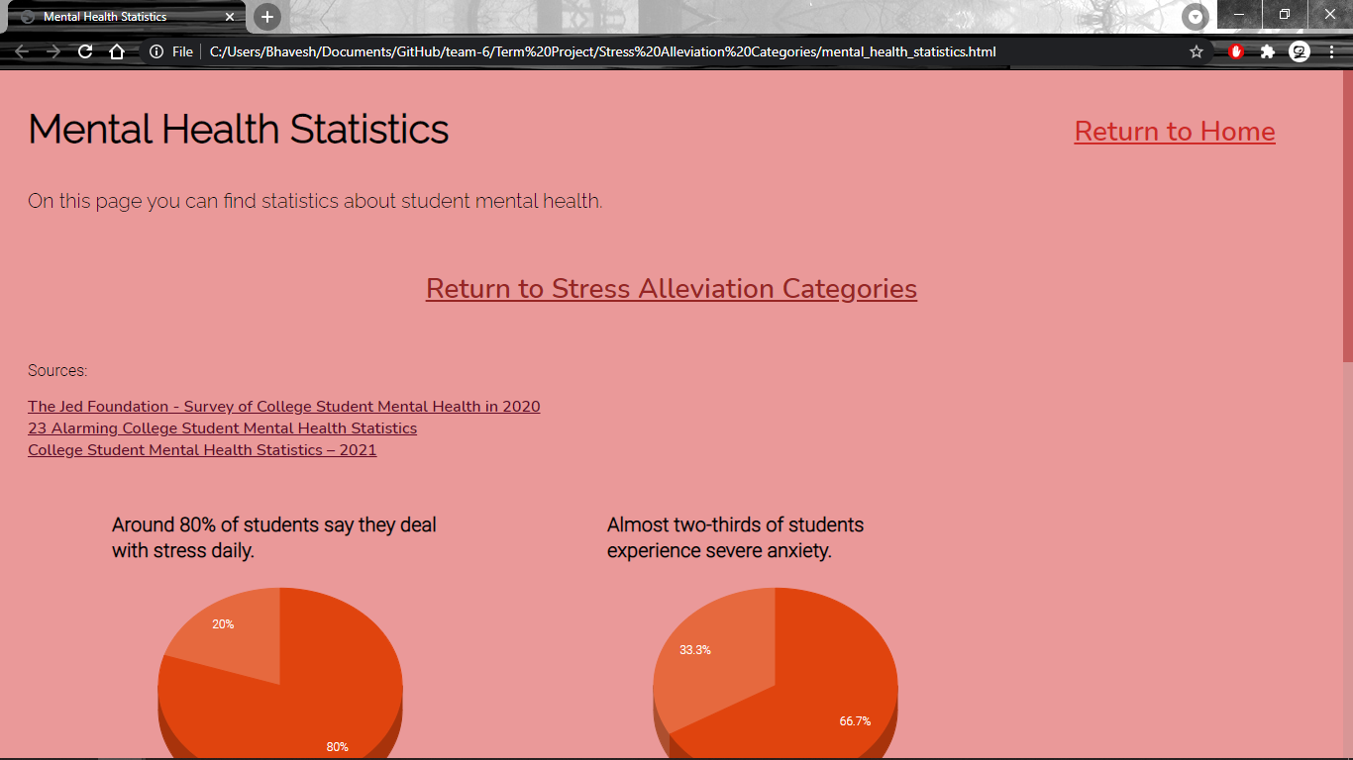
Mental Health Statistics
Contains various statistics regarding mental health
Each statistic is displayed in a custom pie chart (using the Google Charts API)
Sources for the statistics are linked above the charts

Slide 9
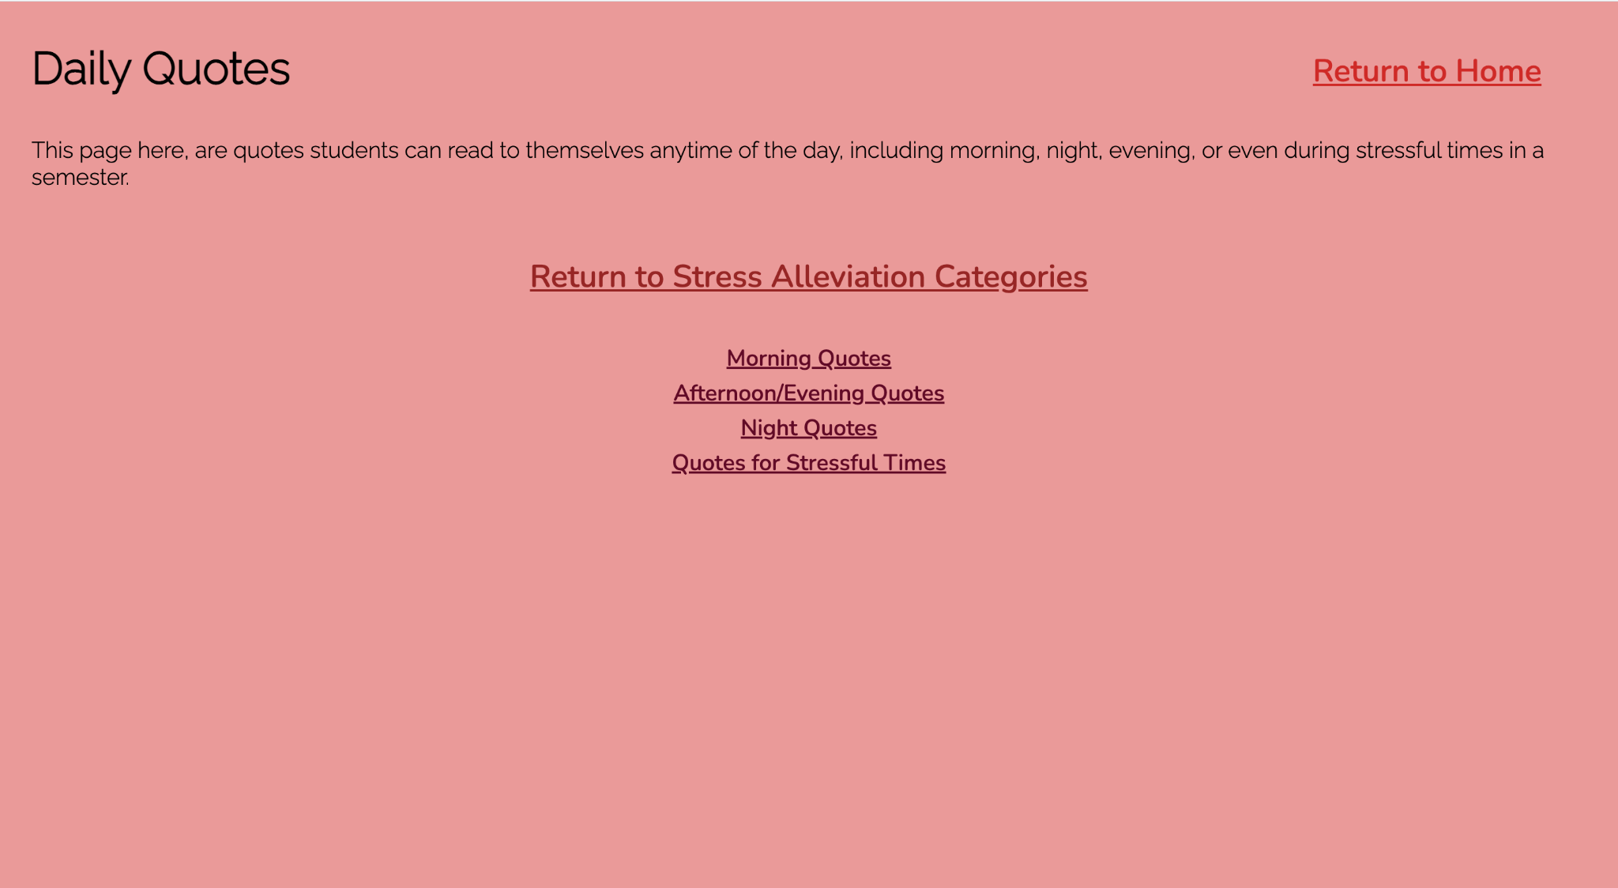
Daily Quotes
Students can read these quotes to themselves
Students have the choice of reading these quotes at anytime of the day
Morning, afternoon, night, or during stressful times
Notes:
-Reading these quotes can be included in their schedule
Jasmine

Slide 10
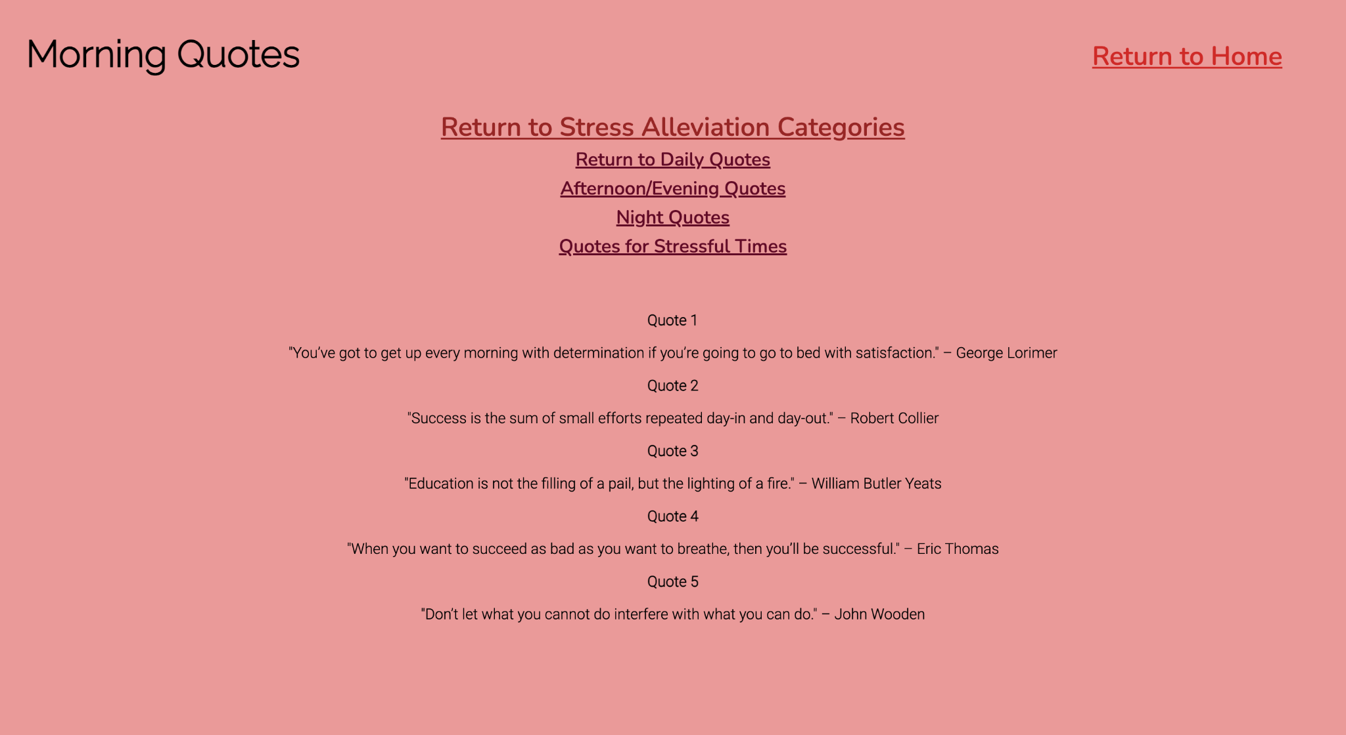
Morning Quotes
Example one of the daily quotes page
Includes who said the quote
Notes:
-The purpose of these quotes is to motivate students when they are feeling discouraged or overwhelmed with the amount of tasks they have to do
-As seen on this page, these quotes can be read in the morning when students are getting ready or on their way to class
Jasmine

Slide 11
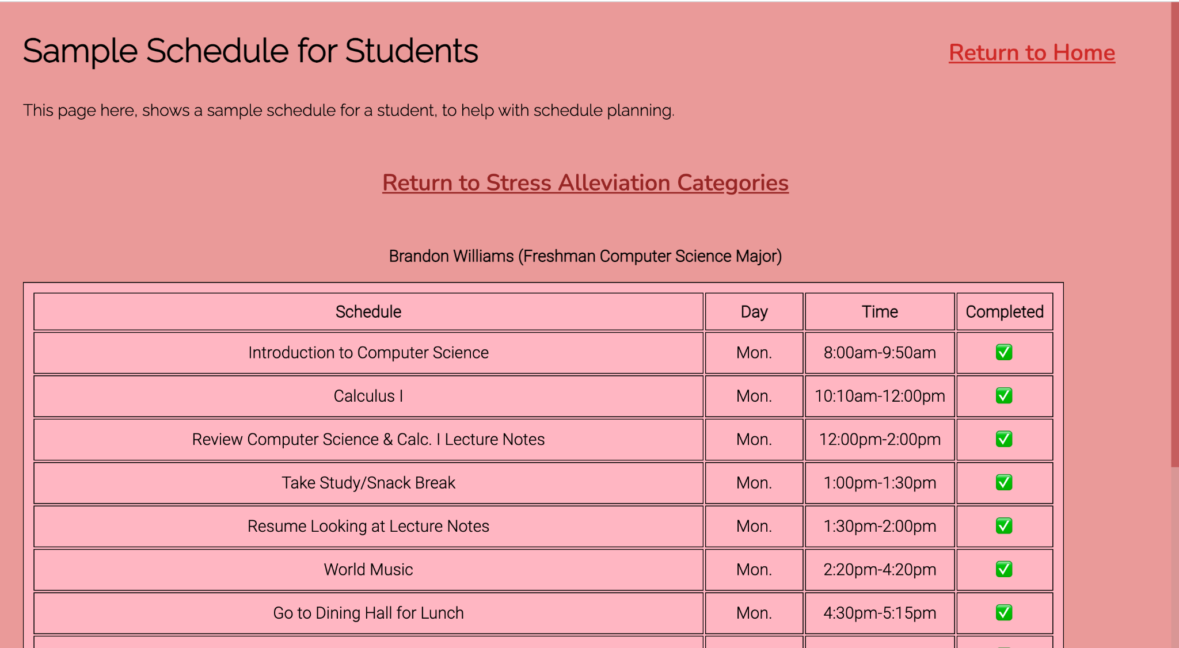
Sample Schedule
An example of how students can put together their schedule
This is a sample schedule helps students get an idea of how they want to organize all the task they need to complete in the day
Brandon’s schedule on a Monday:
Notes:
-This also helps students split their with their academics and times for distress
-This sample schedule has all of the daily tasks that Brian, a freshman CS student, has to complete on a Monday
-There are also time frames of when Brian starts and completes his tasks
-The completed column is where students put a checkmark if they completed their task on that day
Jasmine

Slide 12
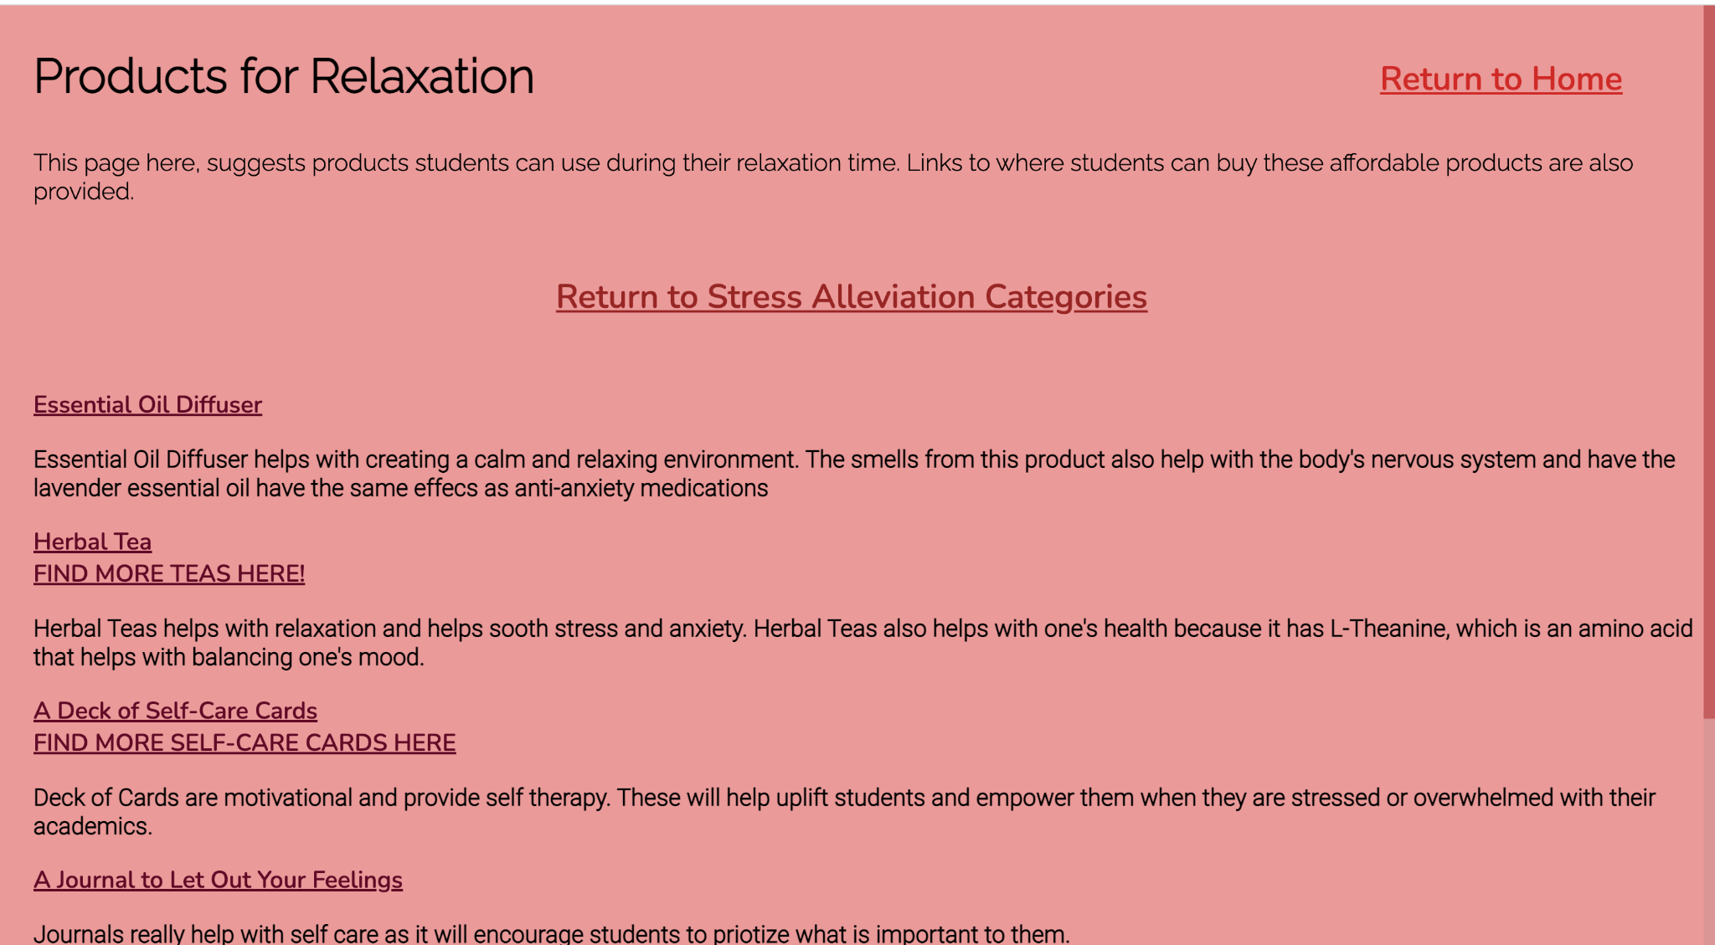
Products for Relaxation
On this page there are a variety of products students can purchase to help reduce their stress and improve their mental health
Affordable websites to buy products
Amazon, Barnes & Nobles, Uncommon Goods, etc.
Notes:
-We also provided a description telling users the purpose of these students and the great effects they have on improving students’ mental health
Jasmine

Slide 13
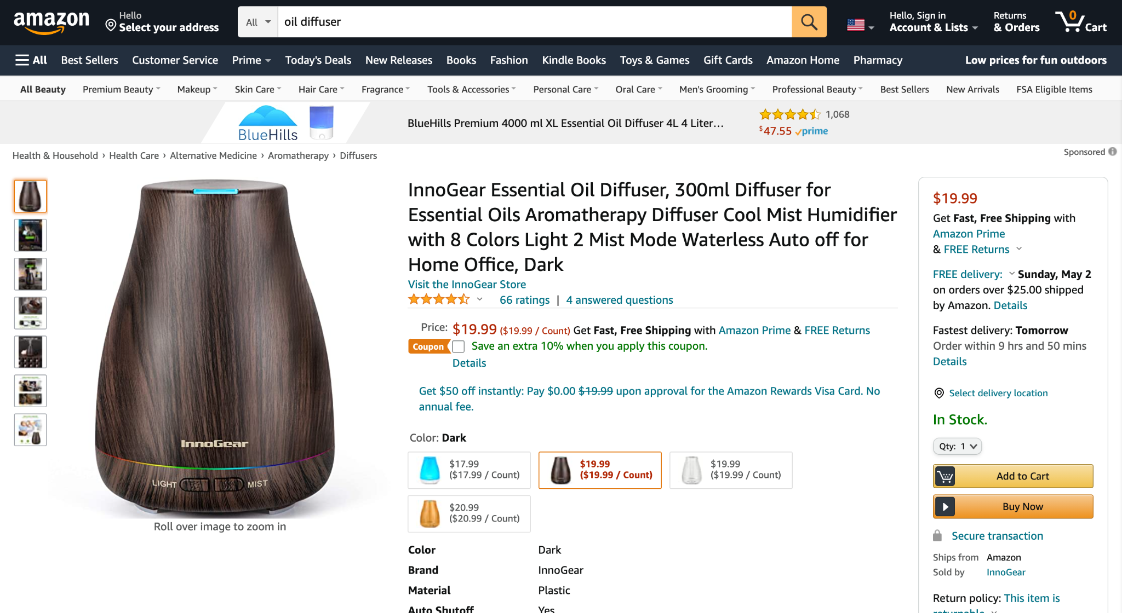
Essential Oil Diffuser from Amazon
Notes:
Jasmine

Slide 14
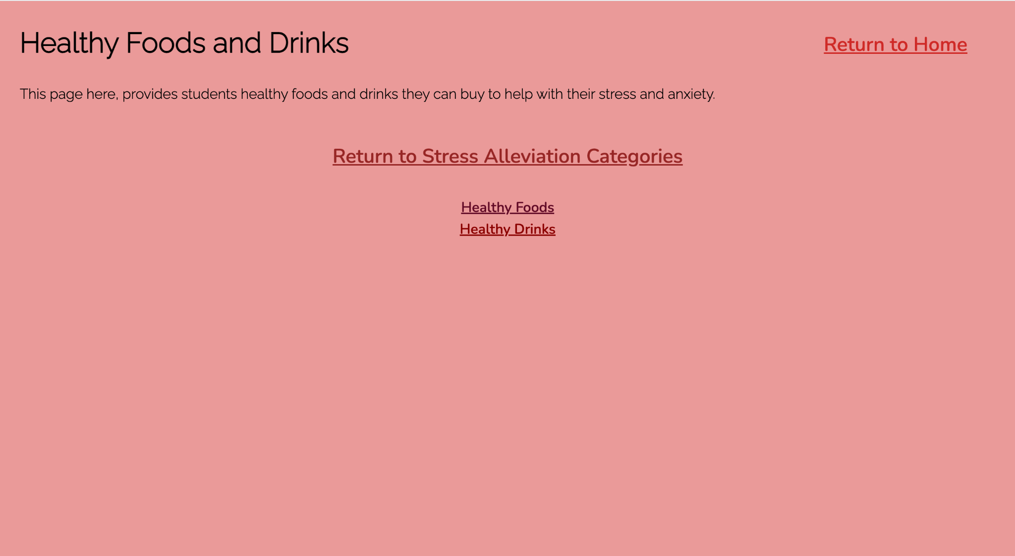
Food and Drink Products
Also a page that provides foods and drinks that will keep students healthy and stressless
Can easily be found at students’ local grocery stores
Also explains why these products are healthy
Notes:
Jasmine

Slide 15
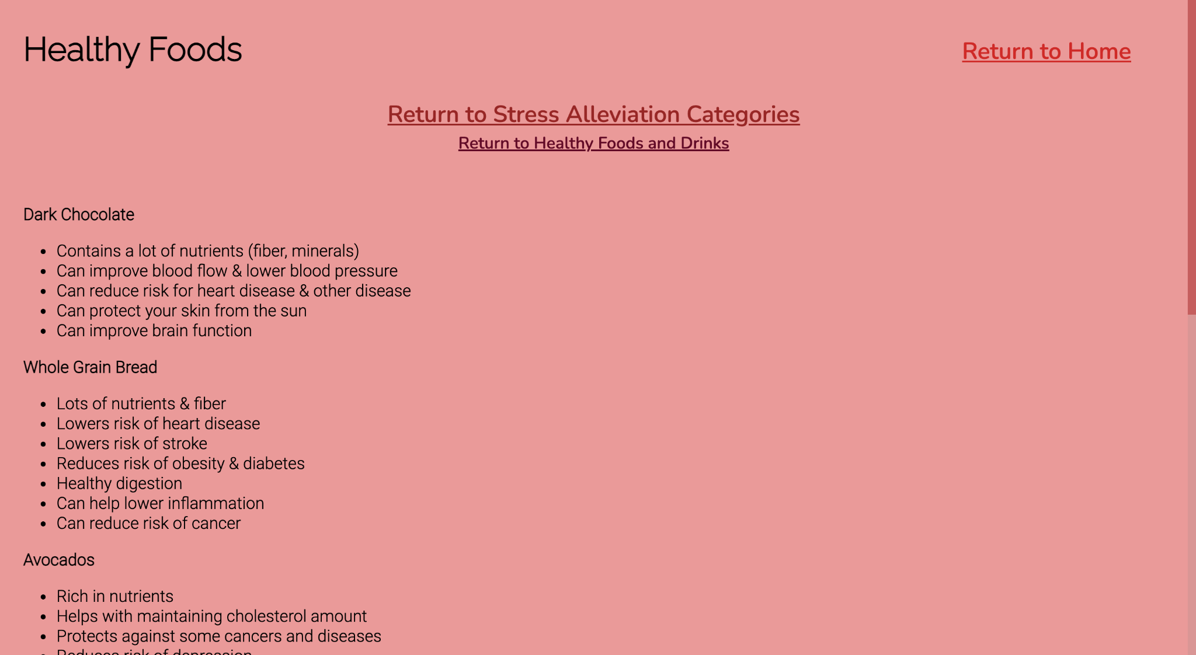
Food Products
Notes:
Jasmine

Slide 16
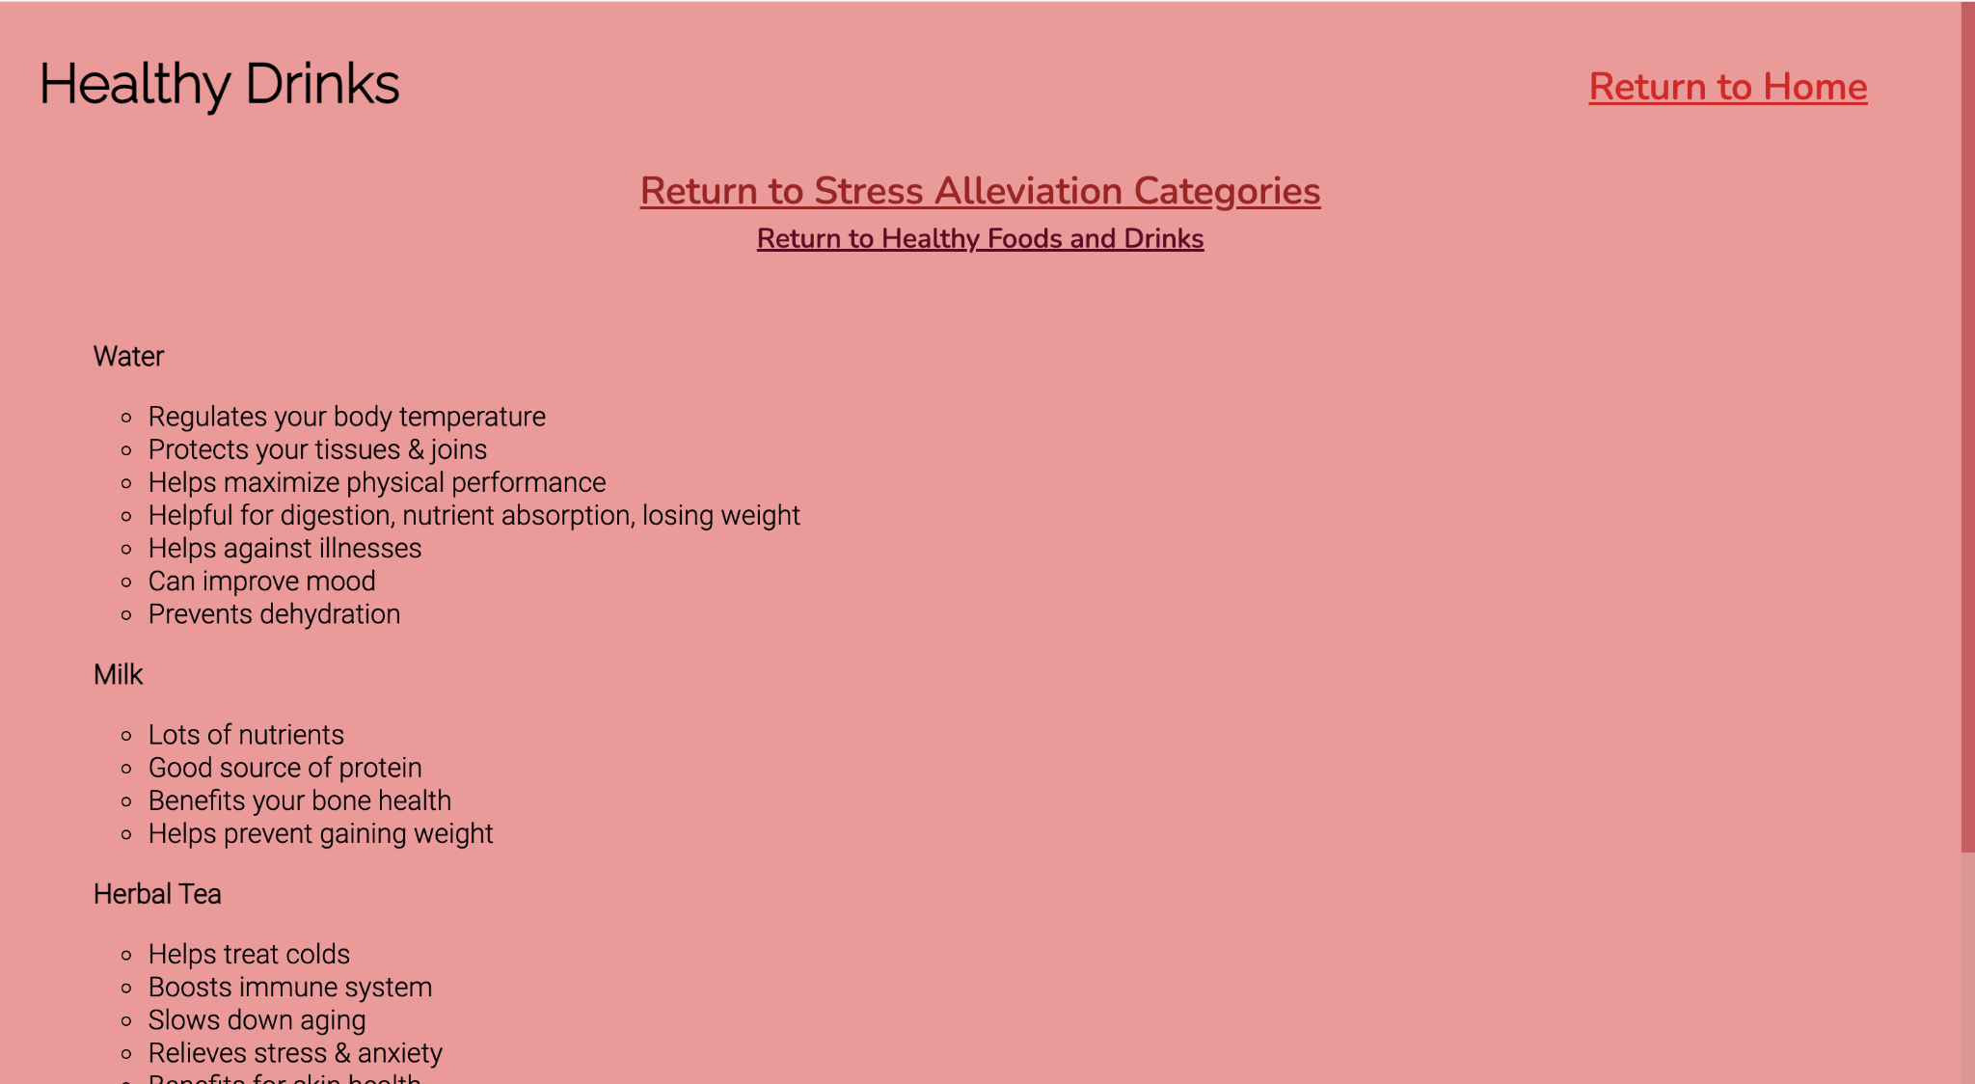
Drink Products
Notes:
Jasmine

Slide 17
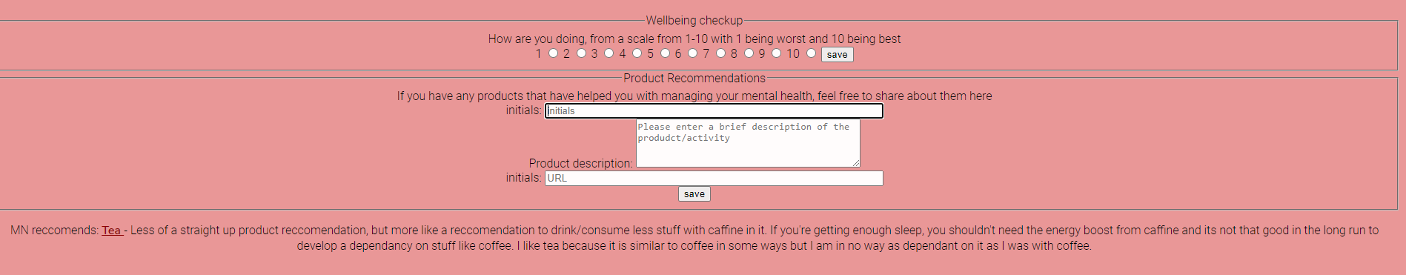
Mental Health Form
Uses jQuery checkbox radio collection for selecting a number from 1-10
Each fieldset has form validation
To be implemented in the future: storing results into a database and using displaying them elsewhere on the site
Currently using ajax to pull a random product from a json file

Slide 18
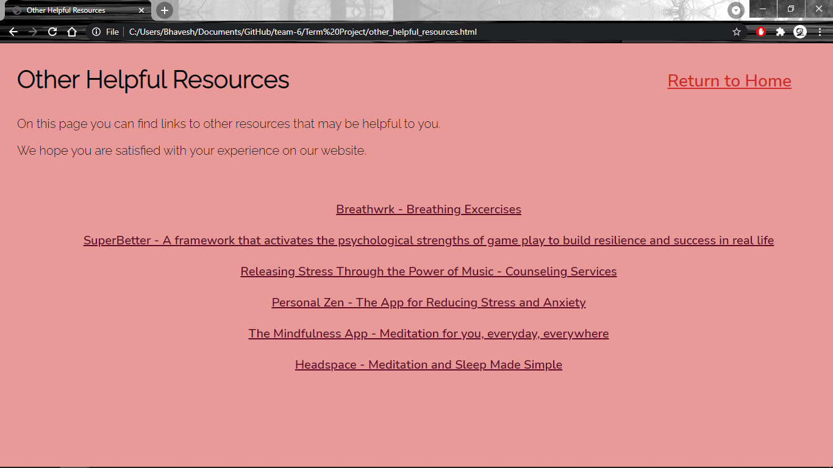
Other Helpful Resources
Contains links to apps and other websites that also help to relieve stress
We hope our user is satisfied with their experience on our website

Slide 19
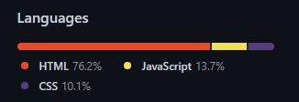
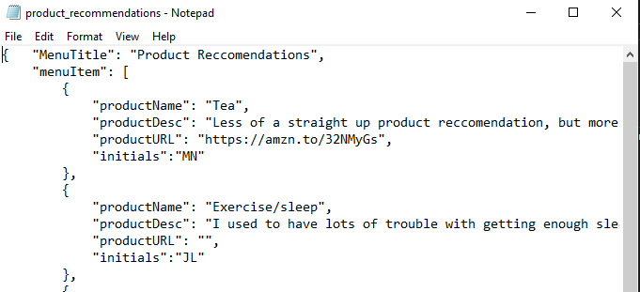
What We Used to Make Our Website
HTML
CSS
JavaScript
JQuery
JQuery Ajax
JSON (to work with Ajax)

Slide 20
Conclusion
-We are students, we know exactly how it feels when your academics can be greatly affected by your mental health
-We wanted to create a website filled with positivity and motivation so that students can push through college day by day
-We did a lot of research to make sure all of the information we provided was reliable and true
-We hope users find our website a great resource to help improve their mental health

Slide 21
ANY QUESTIONS?

Slide 22
Citations
Amanda Loudin April 12, and Amanda Loudin. “Why You Should Eat Plant-Based Foods After a Workout, According to Dietitians.” EatingWell, 12 Apr. 2021, www.eatingwell.com/article/7898294/best-plant-post-workout-foods-according-to-dietitians/.
“20 Foods That Can Help Relieve Stress.” Health.com, www.health.com/food/stress-relieving-foods?slide=5829212e-a7da-48b1-a33c-ccd285a25afb#5829212e-a7da-48b1-a33c-ccd285a25afb.
Willard, Haley. “5 Drinks That Reduce Stress (Slideshow).” The Daily Meal, The Daily Meal, 14 Nov. 2013, www.thedailymeal.com/drink/5-drinks-reduce-stress-slideshow/slide-3.
Siegel, Kalah, et al. “10 Best Foods to Fight Off Stress: Everyday Health.” EverydayHealth.com, www.everydayhealth.com/diet-nutrition-pictures/how-to-reduce-stress-with-diet.aspx.
Broggini, Isabella. “The 12 Best Stress Relief Products of 2021, According to Our Editors.” Verywell Mind, 27 Dec. 2020, www.verywellmind.com/best-stress-relief-products-5087253.
“Inspirational Quotes to Help You Stay Motivated Through College.” Go to Independence University, www.independence.edu/blog/inspiring-quotes-to-stay-motivated.
Bhatt, Ananya, et al. “190 Inspirational and Motivational Quotes For Students In College.” The Random Vibez, 22 Oct. 2019, www.therandomvibez.com/1inspirational-quotes-for-students-in-college/.

Slide 23
Citations (continued)
“College Student Mental Health Statistics – 2021.” Admissionsly, 2021, https://admissionsly.com/college-student-mental-health-statistics/. Accessed 26 April 2021.
“Survey of College Student Mental Health in 2020.” The Jed Foundation, 22 October 2020, https://www.jedfoundation.org/survey-of-college-student-mental-health-in-2020/. Accessed 26 April 2021.
Vuleta, Branka. “23 Alarming College Student Mental Health Statistics.” What To Become, 12 April 2021, https://whattobecome.com/blog/college-student-mental-health-statistics/. Accessed 26 April 2021.

